Slide 1

Optimizing Book Sales with Predictive Analytics and Recommendation Systems
Team members:
1.P Sai kiran
2.Jaswanthi
3.Harish reddy
4.r santhosh
5.subramanyam

Slide 2


ABSTRACTION:
This project focuses on recommending books based on the number of books an author has published and their bestselling performance.
By analyzing authors with the highest number of publications and identifying their top-selling works, we deliver personalized book suggestions.
This method helps readers explore popular authors and their best books, ensuring they find engaging and high-quality reads.

Slide 3
Introduction :
Objective: Implement a recommendation system to suggest books to users based on historical sales trends, author performance, and reader preferences.
Dataset: Consists of 1044 samples and 6 features (2 numerical and 4 categorical).
Sales in million: The target label represents categories such as the sales figures, measured in millions, for individual books.
Data-Driven Insights: Utilize historical book sales data to uncover patterns and trends that can inform marketing strategies and inventory management for publishers and retailers.
Predictive Modeling: Develop a predictive model that forecasts future book sales based on variables such as genre, author popularity, publication year, and language, enabling better business decisions.
Recommendation System Enhancement: Create an advanced recommendation system that suggests books to readers based on their preferences, reading history, and correlations with bestselling titles, thereby improving user experience.

Slide 4

Features in the Dataset:
Key Features:
Book: The title or name of the book.
Author(s): The author or authors who wrote the book
Original Language: The Language in which the book was originally written.
First Published: The date when the was first published.
Sales in Millions: The approximate number of book copies sold in millions
Genre: The genre or category to which the book belong
Target Feature: Book sales (in millions)

Slide 5
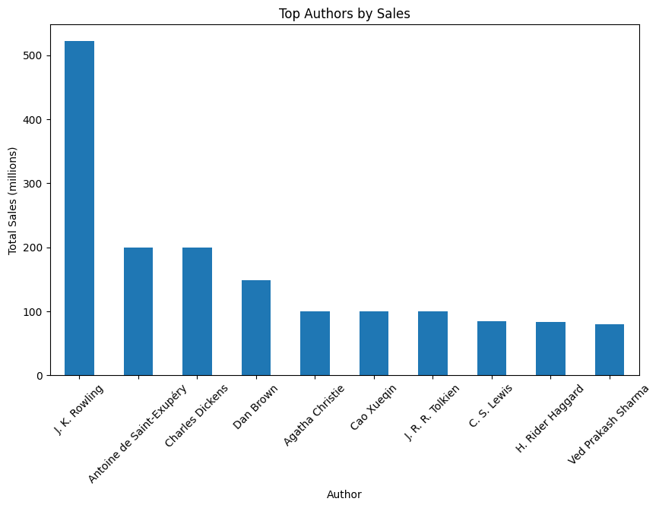
Top Authors by Sales:
Bar plot :used to identify the top author who has the highest book and sales
1. The J.K . Rowling has the highest number of
book and sales.
2.The Antoine is the second highest author.
3. The Ved Prakash Sharma has the lowest
number of book and sales.

Slide 6
Author Selection Justification:
Top Performing Author: J.K. Rowling was chosen for analysis due to her status as the highest-selling author in the dataset, making her an ideal candidate for identifying key trends in bestselling books.
Sales Insights: By analyzing J.K. Rowling’s sales data, the project aims to uncover patterns related to genre popularity, reader demographics, and global sales distribution.
Impact on Recommendation Systems: J.K. Rowling’s success provides valuable insights into user preferences and can be used to refine the recommendation engine by highlighting bestselling books in similar genres or themes.
Language and Global Reach: J.K. Rowling’s books have been translated into multiple languages, allowing the project to explore the correlation between translation and increased sales across different regions.
Trend Analysis: The project uses Rowling’s consistent success to analyze long-term book sales trends and predict future bestsellers based on similar author and genre performance metrics.

Slide 7
Measuring Relationships and Method Overview:
Correlation Analysis: Utilizes the corrwith() method from Pandas to compute the correlation between two Series.
Understanding Relationships: Measures how closely two variables (e.g., book sales) move in relation to one another.
Resulting Insights: Produces a Series of correlation coefficients for each book in the dataset, reflecting their relationship with "Harry Potter."
Application in Recommendations: Identifies books with sales patterns similar to "Harry Potter," aiding in recommendation systems.
Statistical Significance: A high positive correlation indicates similar sales trends, while a negative correlation suggests inverse relationships

Slide 8
Model Evaluation:
Based on the analysis, I have recommended the top books by J.K. Rowling, highlighting their strong sales performance and popularity. These recommendations are grounded in correlation analysis, showcasing titles that exhibit similar sales patterns to the "Harry Potter" series. This approach not only identifies high-performing books but also enhances user engagement through tailored suggestions.
Index | Correlation | sales_in_millions
Harry Potter and the Chamber of Secrets | 1.0 | 120.0
Harry Potter and the Deathly Hallows | 1.0 | 77.0
Harry Potter and the Goblet of Fire | 1.0 | 65.0
Harry Potter and the Half-Blood Prince | 1.0 | 65.0
Harry Potter and the Order of the Phoenix | 1.0 | 65.0
Harry Potter and the Philosopher's Stone | 1.0 | 65.0
Harry Potter and the Prisoner of Azkaban | 1.0 | 65.0

Slide 9
Conclusion:
In this project, we looked at best-selling books to find interesting information about authors and sales. Here are the main points:
Top Authors and Genres: We discovered who the most active authors are and which genres are the most popular, giving us a clear view of what readers like.
Sales Distribution: Our charts showed how sales differ by genre and language, highlighting the categories that perform best.
J.K. Rowling's Impact: We focused on J.K. Rowling's books to see her strong sales and how other titles relate to "Harry Potter," showing her continued popularity.

Slide 10
Applications of BOOK RECOMMENDATION Project:
Personalized Book Recommendations: By leveraging machine learning algorithms, the system can predict user preferences based on their reading history and recommend books that align with their tastes, improving reader engagement.
Predicting Bestseller Potential: Publishers can use the predictive models to identify which upcoming books have the highest potential to become bestsellers, optimizing marketing budgets and launch strategies.
Language and Region-based Recommendations: Expand the recommendation engine to support recommendations in multiple languages and regions, tailored to cultural and linguistic preferences.
Real-Time Sales Prediction Dashboard: Build an interactive dashboard that provides real-time book sales predictions based on emerging market trends, user preferences, and social media buzz, allowing publishers to make quick decisions.

Slide 11
Any Queries ?
Feel free to ask!

